Slide 1

End-to-End AWS-Based Text Classification System
Under supervision Abdelrahman Ahmed
Team Member
Mennatallah Ibrahim Kamal
Manar Mohamed Mahdy

Slide 2
Agenda
Problem Definition
Objectives
Datasets
Preprocessing
Methodology
Experimental Results
Application

Slide 3
Problem Definition
As the transportation sector continues to evolve with the integration of technology, understanding user review becomes essential for improving services and user experience.
Arabic sentiment classification can provide insights into customer satisfaction, preferences, and areas needing enhancement.
With millions of Arabic-speaking users engaging with transportation apps for ride-hailing, public transport information, and logistics, harnessing the power of sentiment classification allows companies to gauge user opinions and make data-driven decisions.

Slide 4
Several types of review classifications:
Sentiment Classification
Emotion Detection
Star Rating Classification
Actionability Classification
User Intent Classification

Slide 5
Objectives
Software App
classification Application
Using Deep Learning Models
The primary objectives of the Arabic sentiment classification project for a transportation app include gathering and aggregating user reviews and feedback from various platforms in Arabic, implementing tailored text preprocessing techniques to address the complexities of the language, and developing robust deep learning models to classify sentiments as positive, negative, or neutral.

Slide 6
Datasets
The dataset contains two columns: review_description, and rating.
The review_description is the Arabic sentence, and the rating is the predicted sentiment analysis and should be one of the following values: 1,0,-1
1 for positive , 0 for Natural and -1 for Negative.
Train data 32036 record consist of the Arabic sentence and the rating
Test data 1000 record consist of the Arabic sentence , the rating and ID

Slide 7
Preprocessing
The preprocessing steps for the Arabic sentiment analysis project, organized into numbered steps:
Remove Unwanted Characters Iterate through a predefined list of unwanted characters (e.g., punctuation, special symbols) and remove them from the review descriptions in both training and testing datasets.
Handle Missing Values replace any empty strings in the review_description with NaN values and subsequently fill these Nan entries with the placeholder "مجهول" (unknown).
Text Normalization normalize Arabic text by standardizing certain characters (e.g., converting variations of "ا" to a single form) to ensure consistency in the text.
Remove Diacritics strip diacritics from the Arabic text to simplify processing and reduce noise.
Remove Emojis implement functions to remove emojis from the text or replace them with descriptive text using a predefined emoji dictionary.

Slide 8
preprocessing , Cont…
Remove Punctuations utilize a translation table to remove both Arabic and English punctuation marks from the reviews.
Remove Repeating Characters use regex to eliminate repeated characters (e.g., turning "لاااا" into "لا").
Tokenization tokenize the cleaned text into individual words or tokens for further analysis.
Stop Words Removal filter out common Arabic stop words from the tokenized text while retaining certain key words that might be relevant for sentiment analysis.
Stemming apply stemming to reduce words to their root forms, using an Arabic stemmer (e.g., ISRIStemmer) to enhance the effectiveness of the analysis.
Final Formatting rejoin the processed tokens into a single string format for the review_description column.

Slide 9
Prepare data to enter models
Split texts into list of words
Tokenization
To-sequence
Get the dictionary mapping each unique word to integer number.
Text becomes sequence of numbers.
Padding
Unit all texts length to one fixed size by getting the maximum length and adding 0’s at the end of short texts.
In case of longer ones remove from the start of text to adjust length

Slide 10
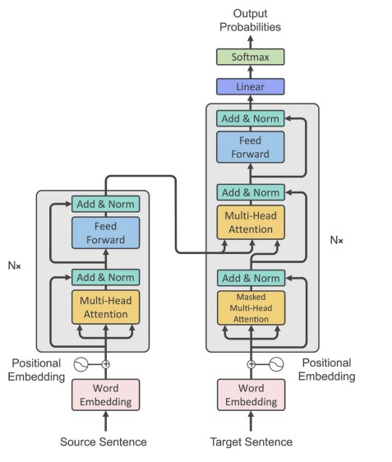
Model building
Embedding Layer: Converts input tokens into dense vectors of fixed size (“d_model: dimension of embedding vector”) .
Multi-Head Attention Layer: Computes self-attention, allowing the model to weigh different words in the input sequence when encoding information.
Residual connections: are crucial in deep neural networks to address the vanishing gradient problem. It helps with the flow of information during training and can mitigate issues like vanishing gradients.
Sequential Layer: used for feature transformation within each transformer block. adjusting the weights to minimize the difference between the predicted output and the true target values.
Dropout Layer: is a regularization technique that helps in reducing overfitting by randomly setting a fraction of input units to zero during each training step.
Pooling Layer: pooling is a technique used to reduce the spatial dimensions of the input tensor.

Slide 11
Hyperparameters of the Transformer model
vocab_size:
Represents the size of the vocabulary, usually derived from the tokenizer's word index.
d_model:
Determines the dimensionality of the word embeddings.
num_heads:
Specifies the number of attention heads to employ in the Multi-Head Attention layer.
ff_dim:
Indicates the dimensionality of the feedforward network used within each Transformer block.
num_transformer_blocks:
Defines the number of Transformer blocks or layers to stack.output_dim: Denotes the number of classes for the classification task.

Slide 12
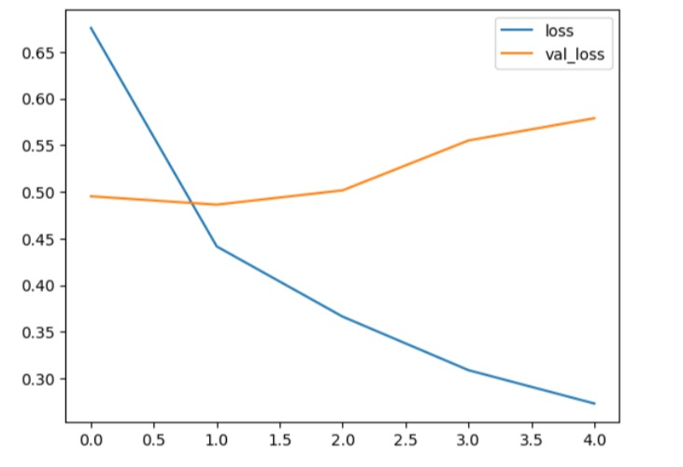
Experimental result
Best hyperparameters:
'd_model': 96,
'Num_heads': 8,
'Ff_dim': 128
Dropout rate': 0.1
Learning rate': 0.00022491452958964034.
Best accuracy 84.16%

Slide 13
Application

